Slide 1
Remote Sensing for Civil Engineers CVEN 5301 Project 1
Group member names: 1) Tushon Dey (ID#20585317)
2)Moatafizur Rahman Shawon (ID#205704570 3)Bhavya Abbu (ID#205579728)

Slide 2
Workload distribution
Group’s member contribution | Bhavya Abbu | Mostafizur R Shawon | Tushon D Babu
Data collection | Collected data from USGS Earth explorer for the decade 2004-2013 and 2014-2023. | Collected data from USGS Earth explorer for the decade 1994-2003. | Collected data from USGS Earth explorer for the decade 1984 – 1993.
Skills | Time Management & Responsibility Accepts fair share of work and reliably completes it by the required time. | Creativity/Originality Problem-solves when faced with impasses or challenges, originates new ideas, initiates team decisions. | Technical Skills Ability to create and develop materials on own initiative, provides technical solutions to problems.
Group meetings conducted offline | 03/07/2023 | 03/13/2023 | 03/17/2023
Online meetings | 03/10/2023 | 03/15/2023 | 03/19/2023
Analysis | Data Sources and preprocessing | Data analysis on histogram equalization and clusters belong to land use classes using a set of ground control points. | PCA analysis and K means Clustering.
Report | Methodology | Criteria | Result discussion and presentation

Slide 3
Project Objective:
Utilize diverse sources of remote sensing data, including Landsat imagery from multiple decades.
Apply EDA techniques such as histogram equalization to understand data distribution and characteristics.
Conduct PCA to analyze variability and patterns over time.
Implement K-means clustering to identify natural groupings.
Optimize cluster count for meaningful segmentation.
Perform HCA to reveal hierarchical structures in the data.
Utilize GCPs to validate and assign land use classes to clusters.
Examine transitions between land cover types to understand dynamics.
Reflect on the validity and reliability of findings based on assumptions.

Slide 4
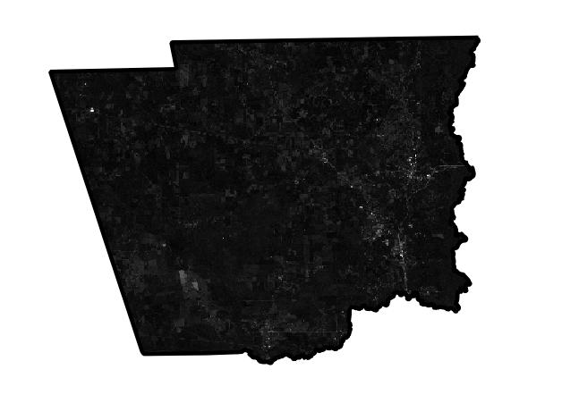
Data Sources, Cloud Cover, and Pre-processing
Selected Decades:
1984–1993 1994–2003 2004–2013 2014–2023 (inclusive)
Study Area data extraction:
Study area: Hardin County
Download country map data from Tx.dot website.
Extract shapefile for Hardin County.
Band image download:
Upload shapefile to Earth Explorer.
We use 0-5% cloud cover.
Study area footprint covered in 2 swaths.
Data Acquisition:
Download all available band data for identified footprints.
Ensure coverage of both satellite swaths.
Clip and Merge:
Clip band files based on the study area shapefile.
Merge clipped bands to create single images for each band.
Image: Hardin County (After merged band images)

Slide 5
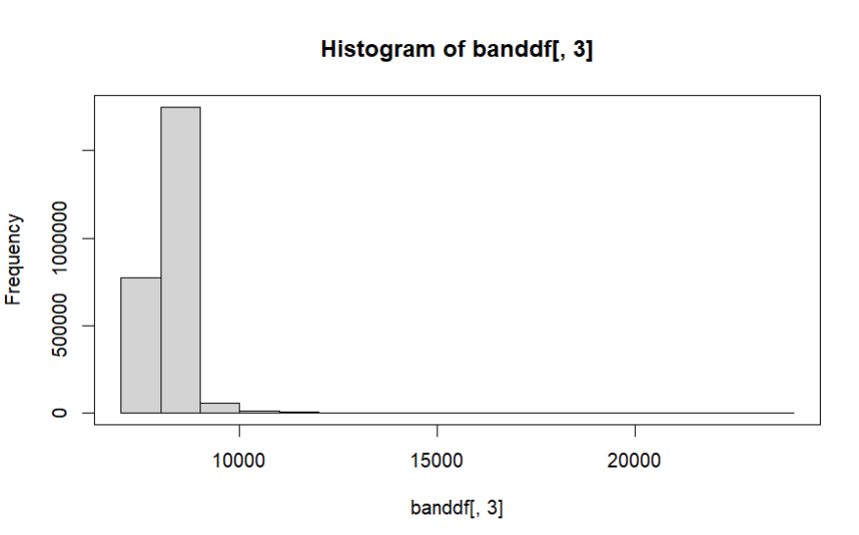
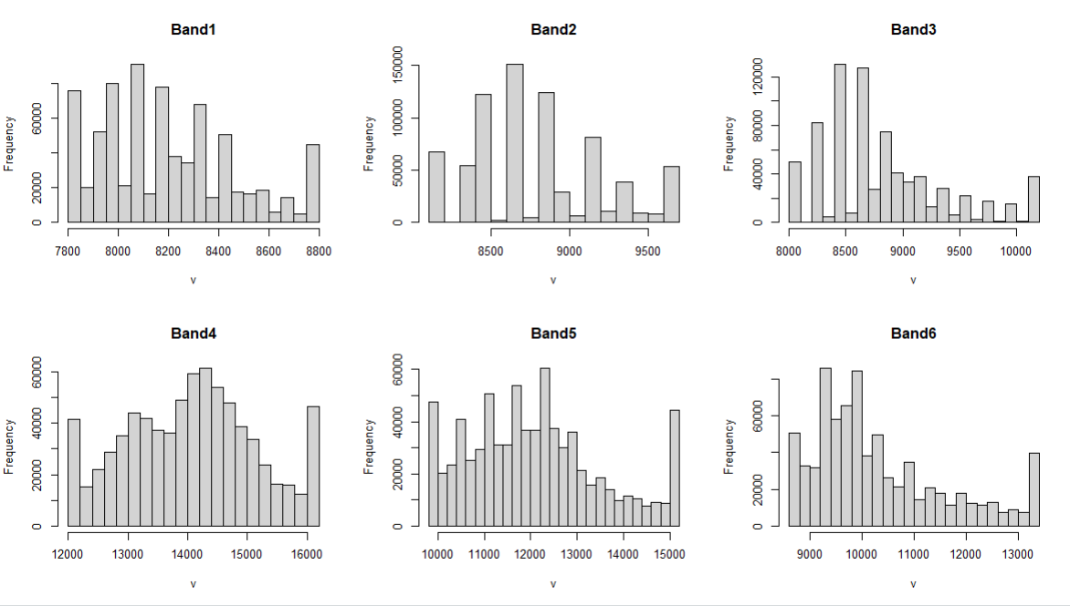
Histogram equalization
Histogram Equalization technique to enhance image contrast and brightness.
Showing Histograms After Equalization highlights redistributed pixel values for improved spread.
Image Quality Improvements contrast and feature visibility. Clearer delineation of land cover types.
From Data Analysis and Equalization Identifying trends and patterns. Standardizing pixel value distribution for enhanced interpretation.
Year: 1994
Year: 1994

Slide 6
PCA Conduct and component loadings change over time
Tighter clusters suggest more homogenous land cover types in a particular decade. Increased dispersion might indicate a higher diversity of land cover types.
Movement Along PC1 (Horizontal Axis):
Think of PC1 as showing changes happening overall.
If points move to the right or left (along the horizontal axis), it means big changes in everything the satellite sees.
Movement Along PC2 (Vertical Axis):
Now, PC2 shows changes happening in specific colors.
If points move up or down (along the vertical axis), it means changes in certain colors, like green or red.

Slide 7
Observation
Spreading Out:
Tighter cluster in early decades (1990-2014) suggests dense and homogeneous forest cover.
Later decades (1990-2014) show a looser cluster, indicating a potential decrease in forest density.
Possible causes include logging, fragmentation, or disturbances.
Shifting Right:
A slight shift to the right along PC1 indicates changes in the overall spectral reflectance properties of the forest.
PC1 captures variance influenced by factors affecting reflectance across all bands.
Rightward shift may suggest decrease in vegetation cover or changes in forest composition.

Slide 8
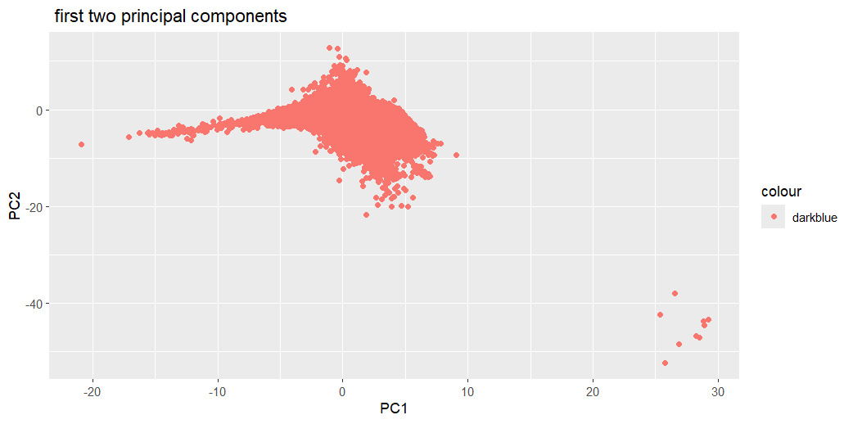
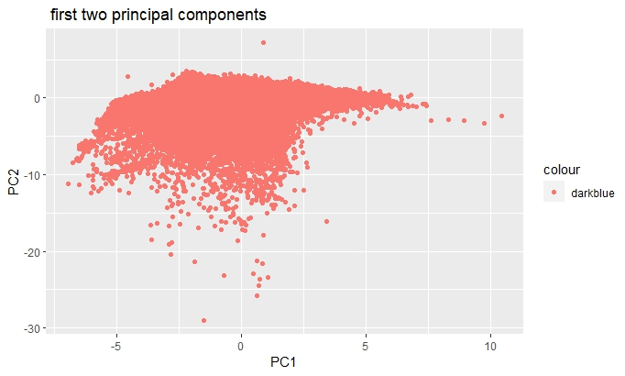
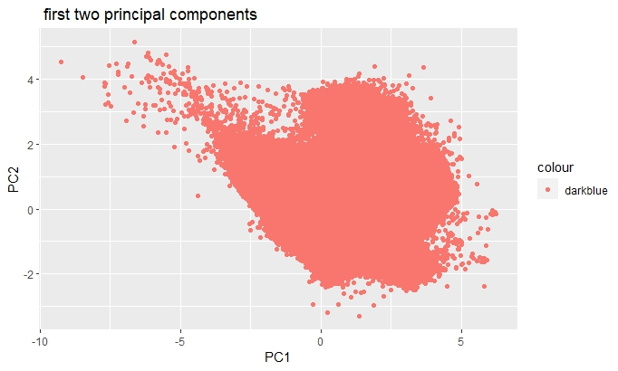
Year: 1990
Year: 2004
Year: 2014

Slide 9
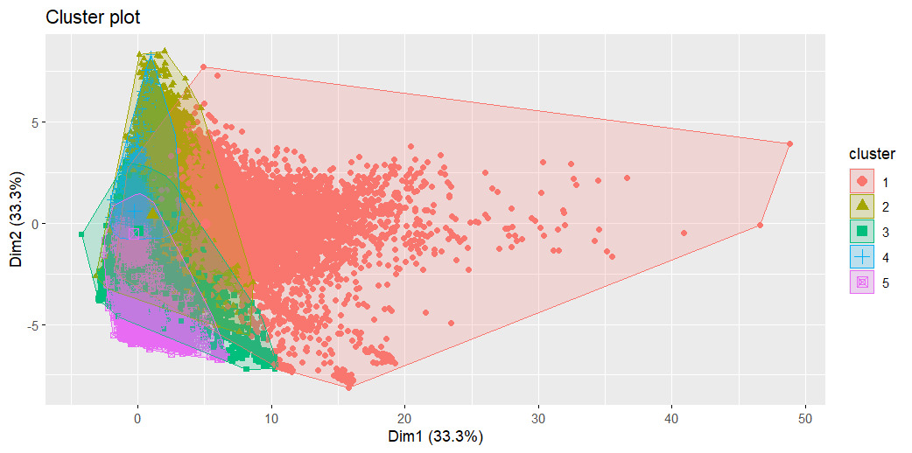
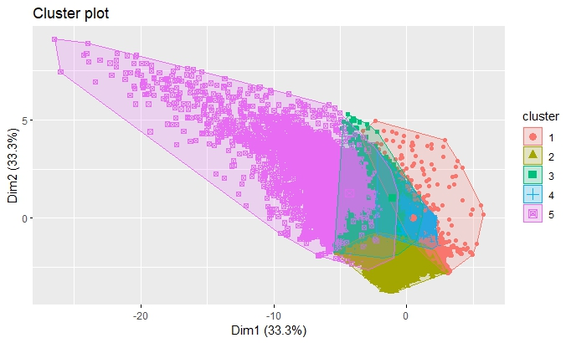
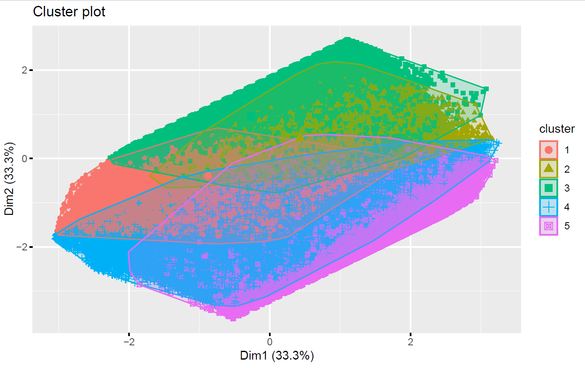
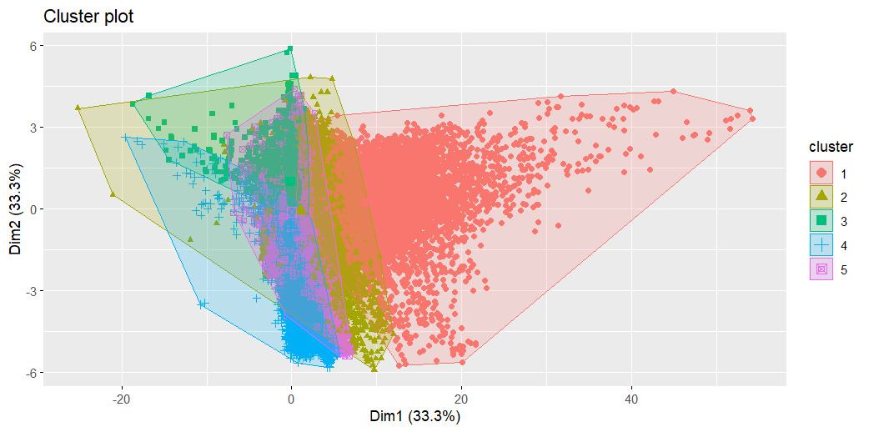
Unsupervised classification using k-means clustering
Year: 2013
Year: 1984
Year: 1994
Year: 2023

Slide 10
Set of ground control points (GCPs)
We set four GCPs to validate our findings and find out the handset type. Those are-
Big thicket National preserve (Forest zone)
Silsbee (City)
Lamberton –Wood crest
Neches river
We have put all those real-life projections from GOOGLE EARTH and created a KML file for that location.
We extract those files and put them into our study zone evaluate them and set the land set types for those bands.

Slide 11
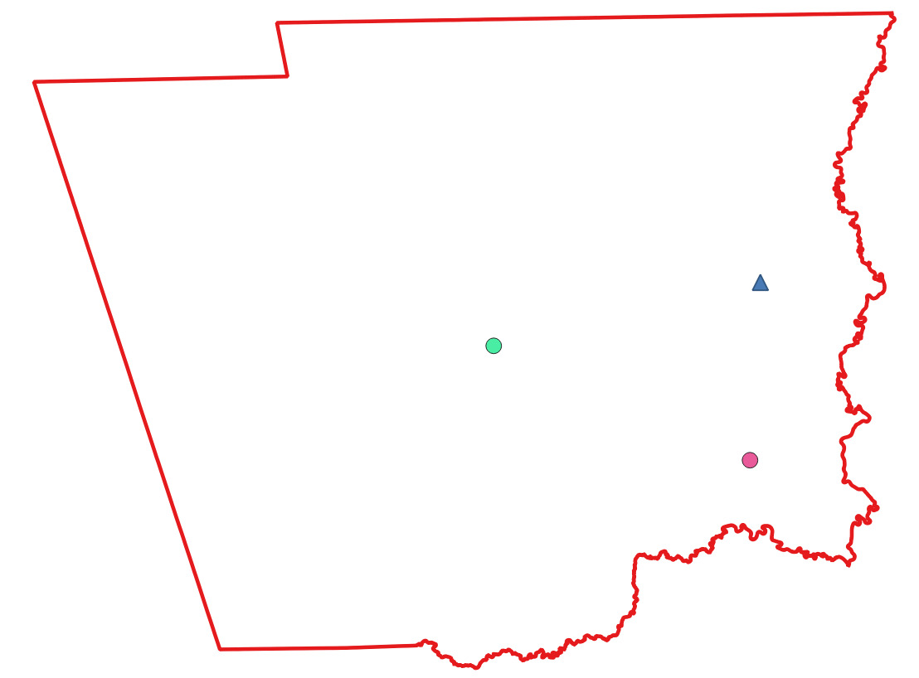
Ground control point for Hardin County

Slide 12
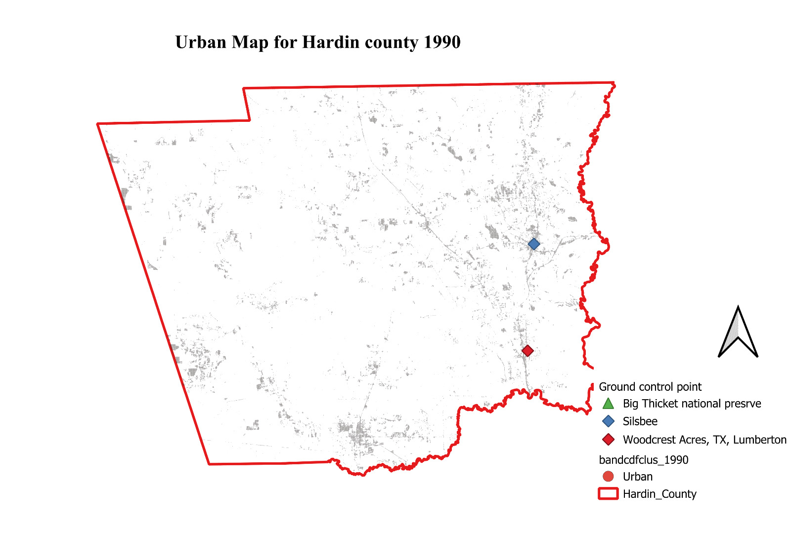
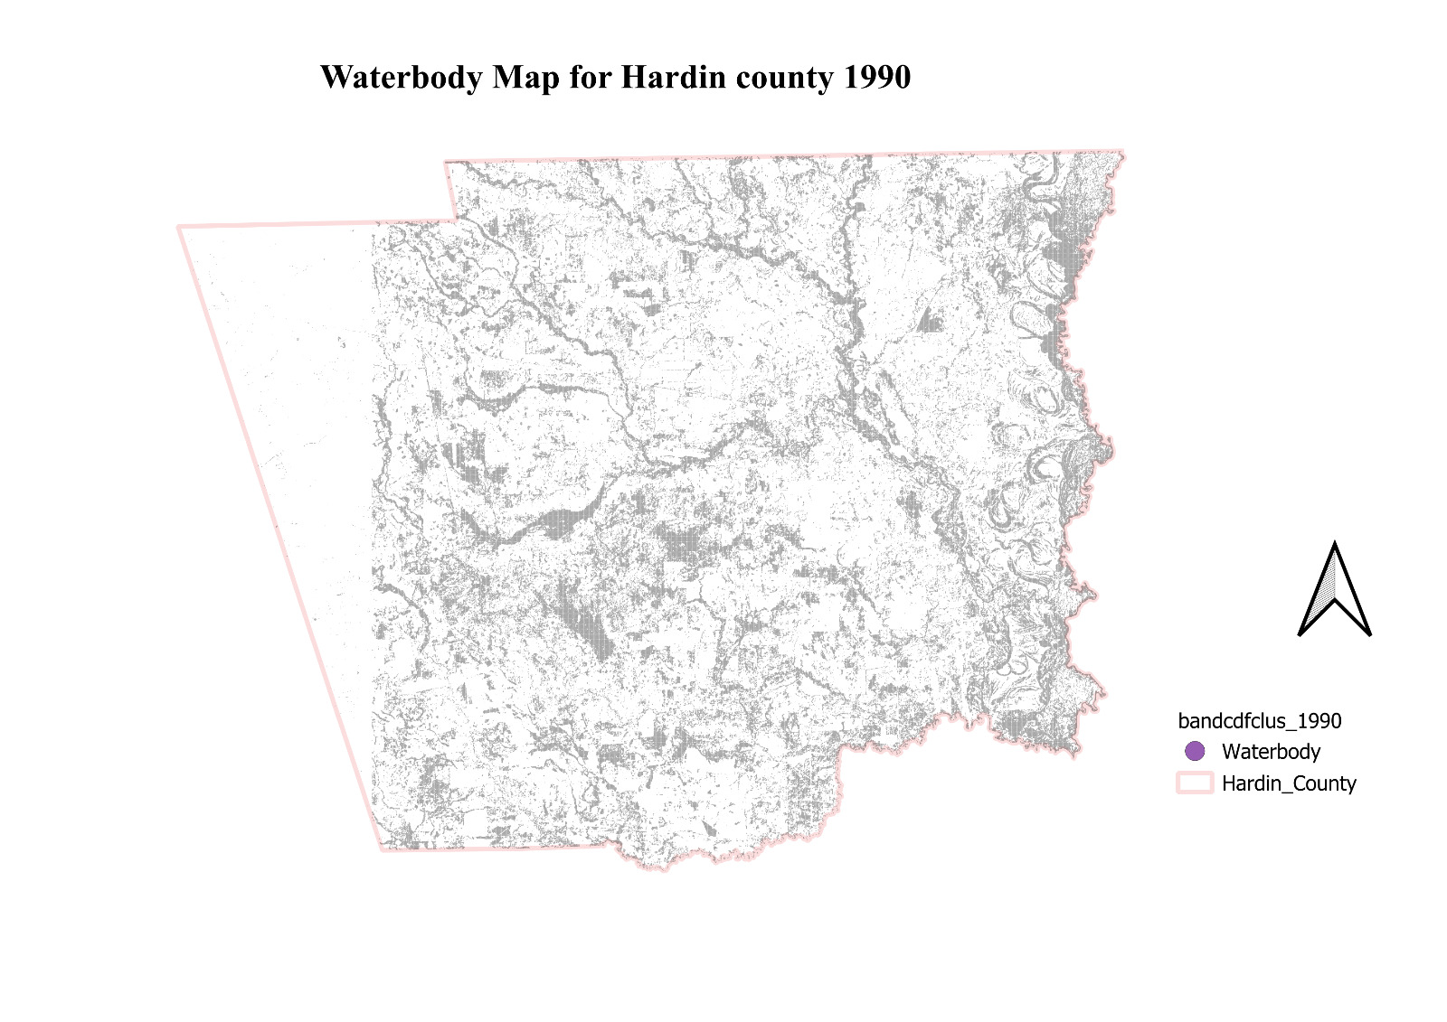

Slide 13
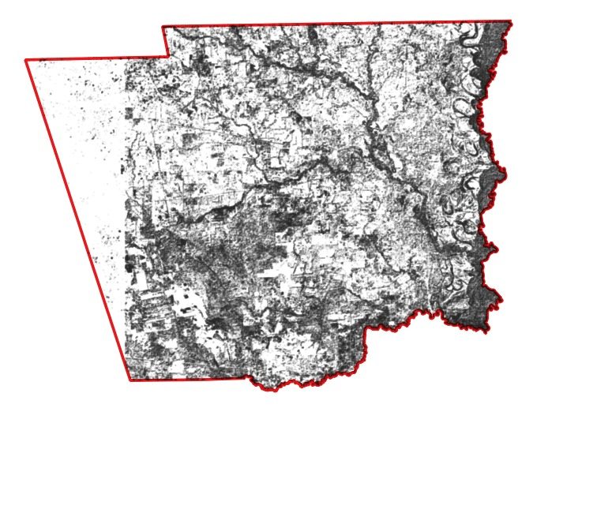
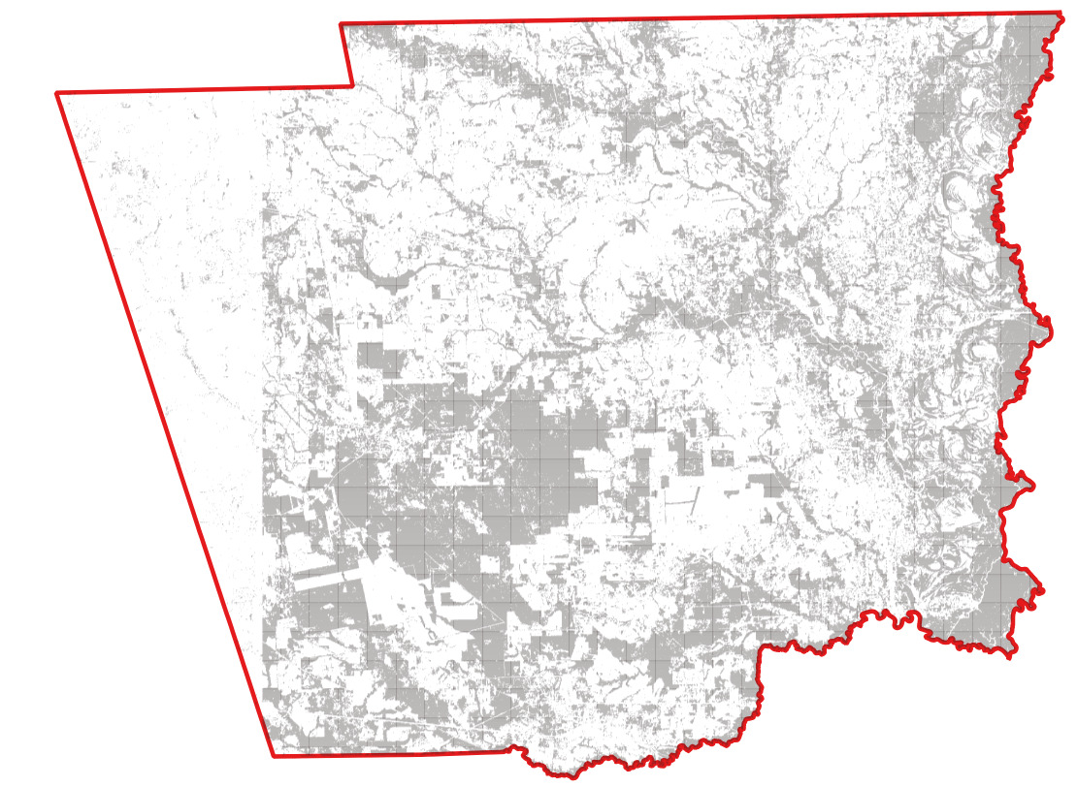
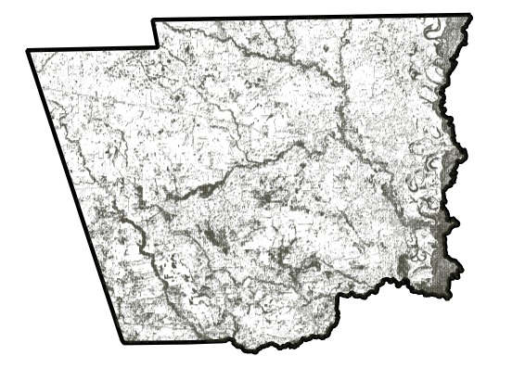
Transition over period (Water body)
Year: 1994
Year: 1990
Year: 1998
Year: 2023

Slide 14
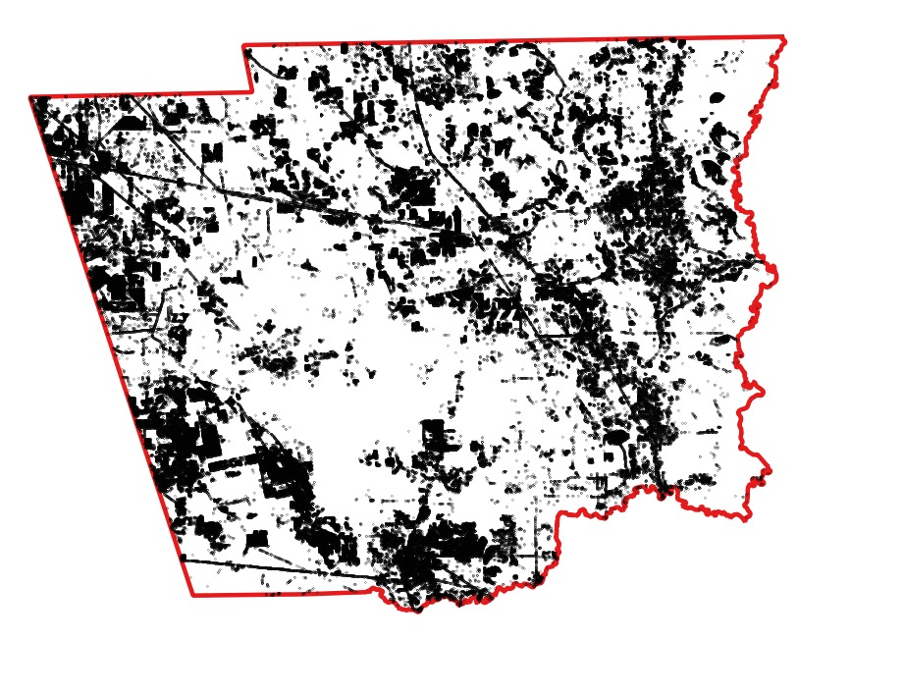
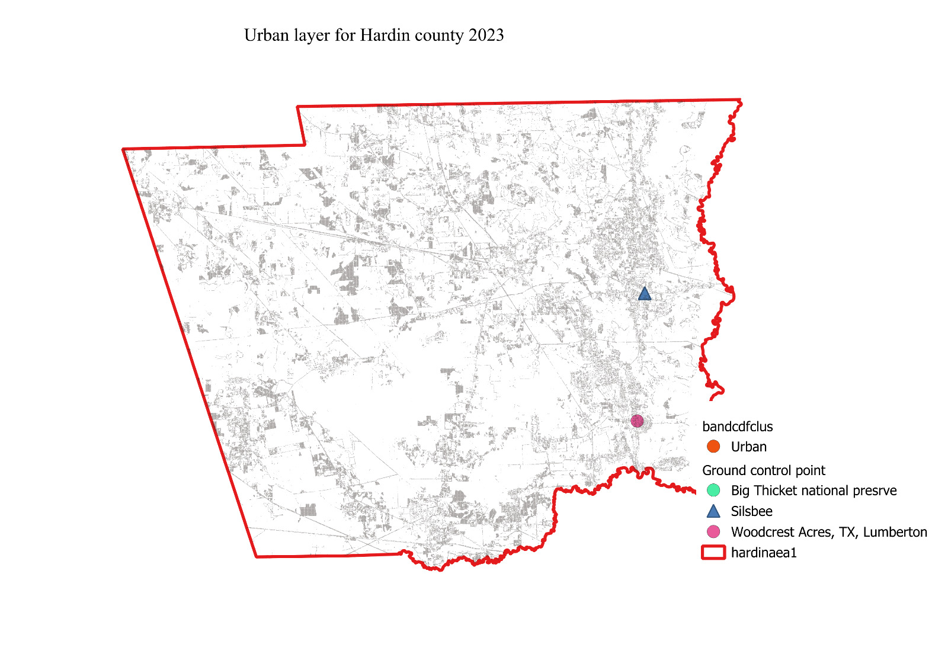
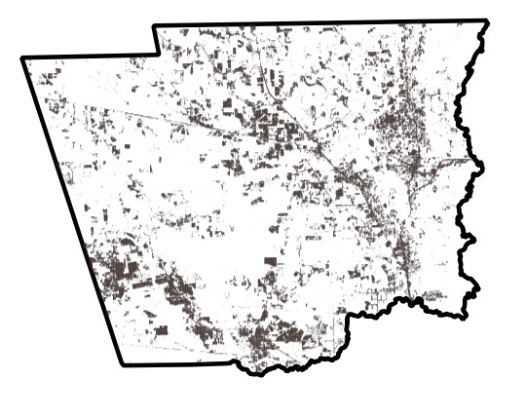
Transition over period (Urban area)
Year: 1994
Year: 1990
Year: 1998
Year: 2023

